Slide 1

Cognizant
Sharing Economy Platform
POD Members Name
Neha Sandeep Kharche
Kuruba Sai Meghana
Chinnahyata Sandeep

Slide 2
INDEX
Abstract
Introduction
Problem Statement
Schematic Diagram
Advantages
Disadvantages
Result
Future Scope
Conclusion

Slide 3
1. Abstract
A sharing economy platform is a type of digital platform that provides the products and services to the users.
This platform enables users to access and offer resources that they might not have been able to access or offer otherwise, creating a more efficient use of resources and reducing waste.
Sharing economy platforms have grown in popularity in recent years due to their ability to increase access to resources and provide new income streams for individuals.

Slide 4
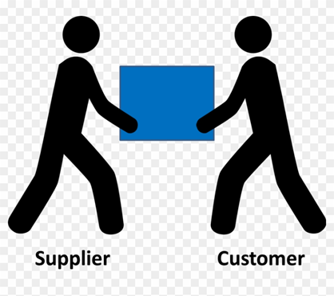
2. Introduction
The central concept of the application is to allow the customer to shop virtually and buy products and book services of their desire.
The application was designed into three modules -
1. First is for the customer who wish to buy the products and book the services.
2. Second is the vendor who maintains and updates the information about the
products and services he is providing.
3. Third is the Admin who can view feedback, able to help to user and also add
product/service category.

Slide 5
3. Problem Statement
There is a growing need for cost-effective and efficient sharing economy platforms that enable individuals and businesses to share resources and services in a convenient and safe manner.
However, the existing sharing economy platforms face several challenges such as trust issues, lack of transparency, inefficient payment systems, and limited options for customization. These challenges often lead to a suboptimal user experience, dissatisfied users, and a lower adoption rate.
Therefore, there is a need for a sharing economy platform that addresses these challenges and provides a seamless and secure user experience while promoting sustainable consumption and reducing waste.

Slide 6
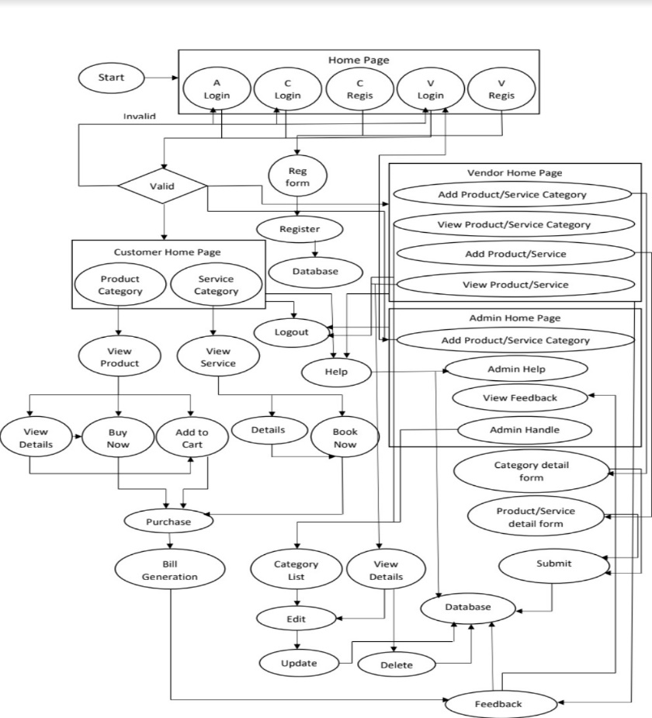
4. Schematic Diagram

Slide 7
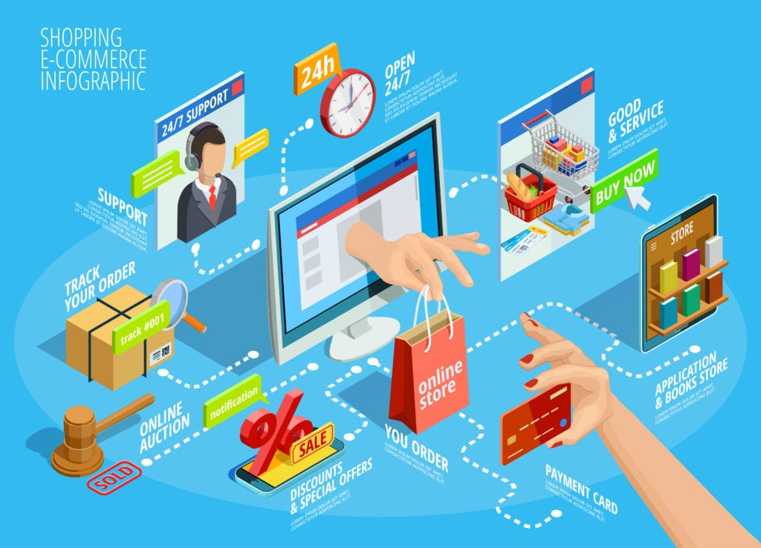
5. Advantages
Faster buying/selling procedure,
as well as easy to find products.
Buying/selling 24/7.
More reach to customers, there
is no theoretical geographic
limitations.
Low operational costs and better
quality of services.
No need of physical company
set-ups.

Slide 8

6. Disadvantages
Unable to examine products personally.
Not everyone is connected to th internet.
Lack of security.
Fear of expectation v/s reality.
Shipping and delivery hassles.

Slide 9
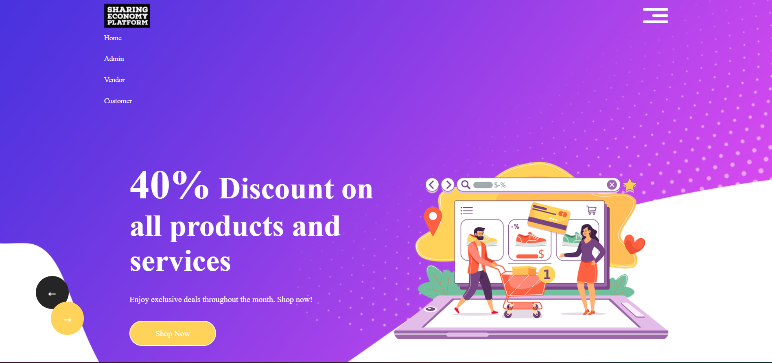
7. Result
Homepage

Slide 10
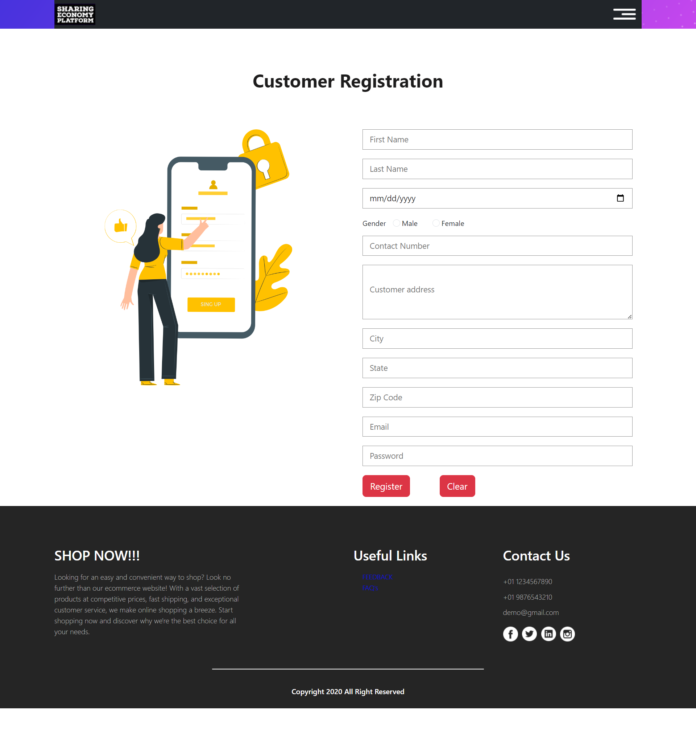
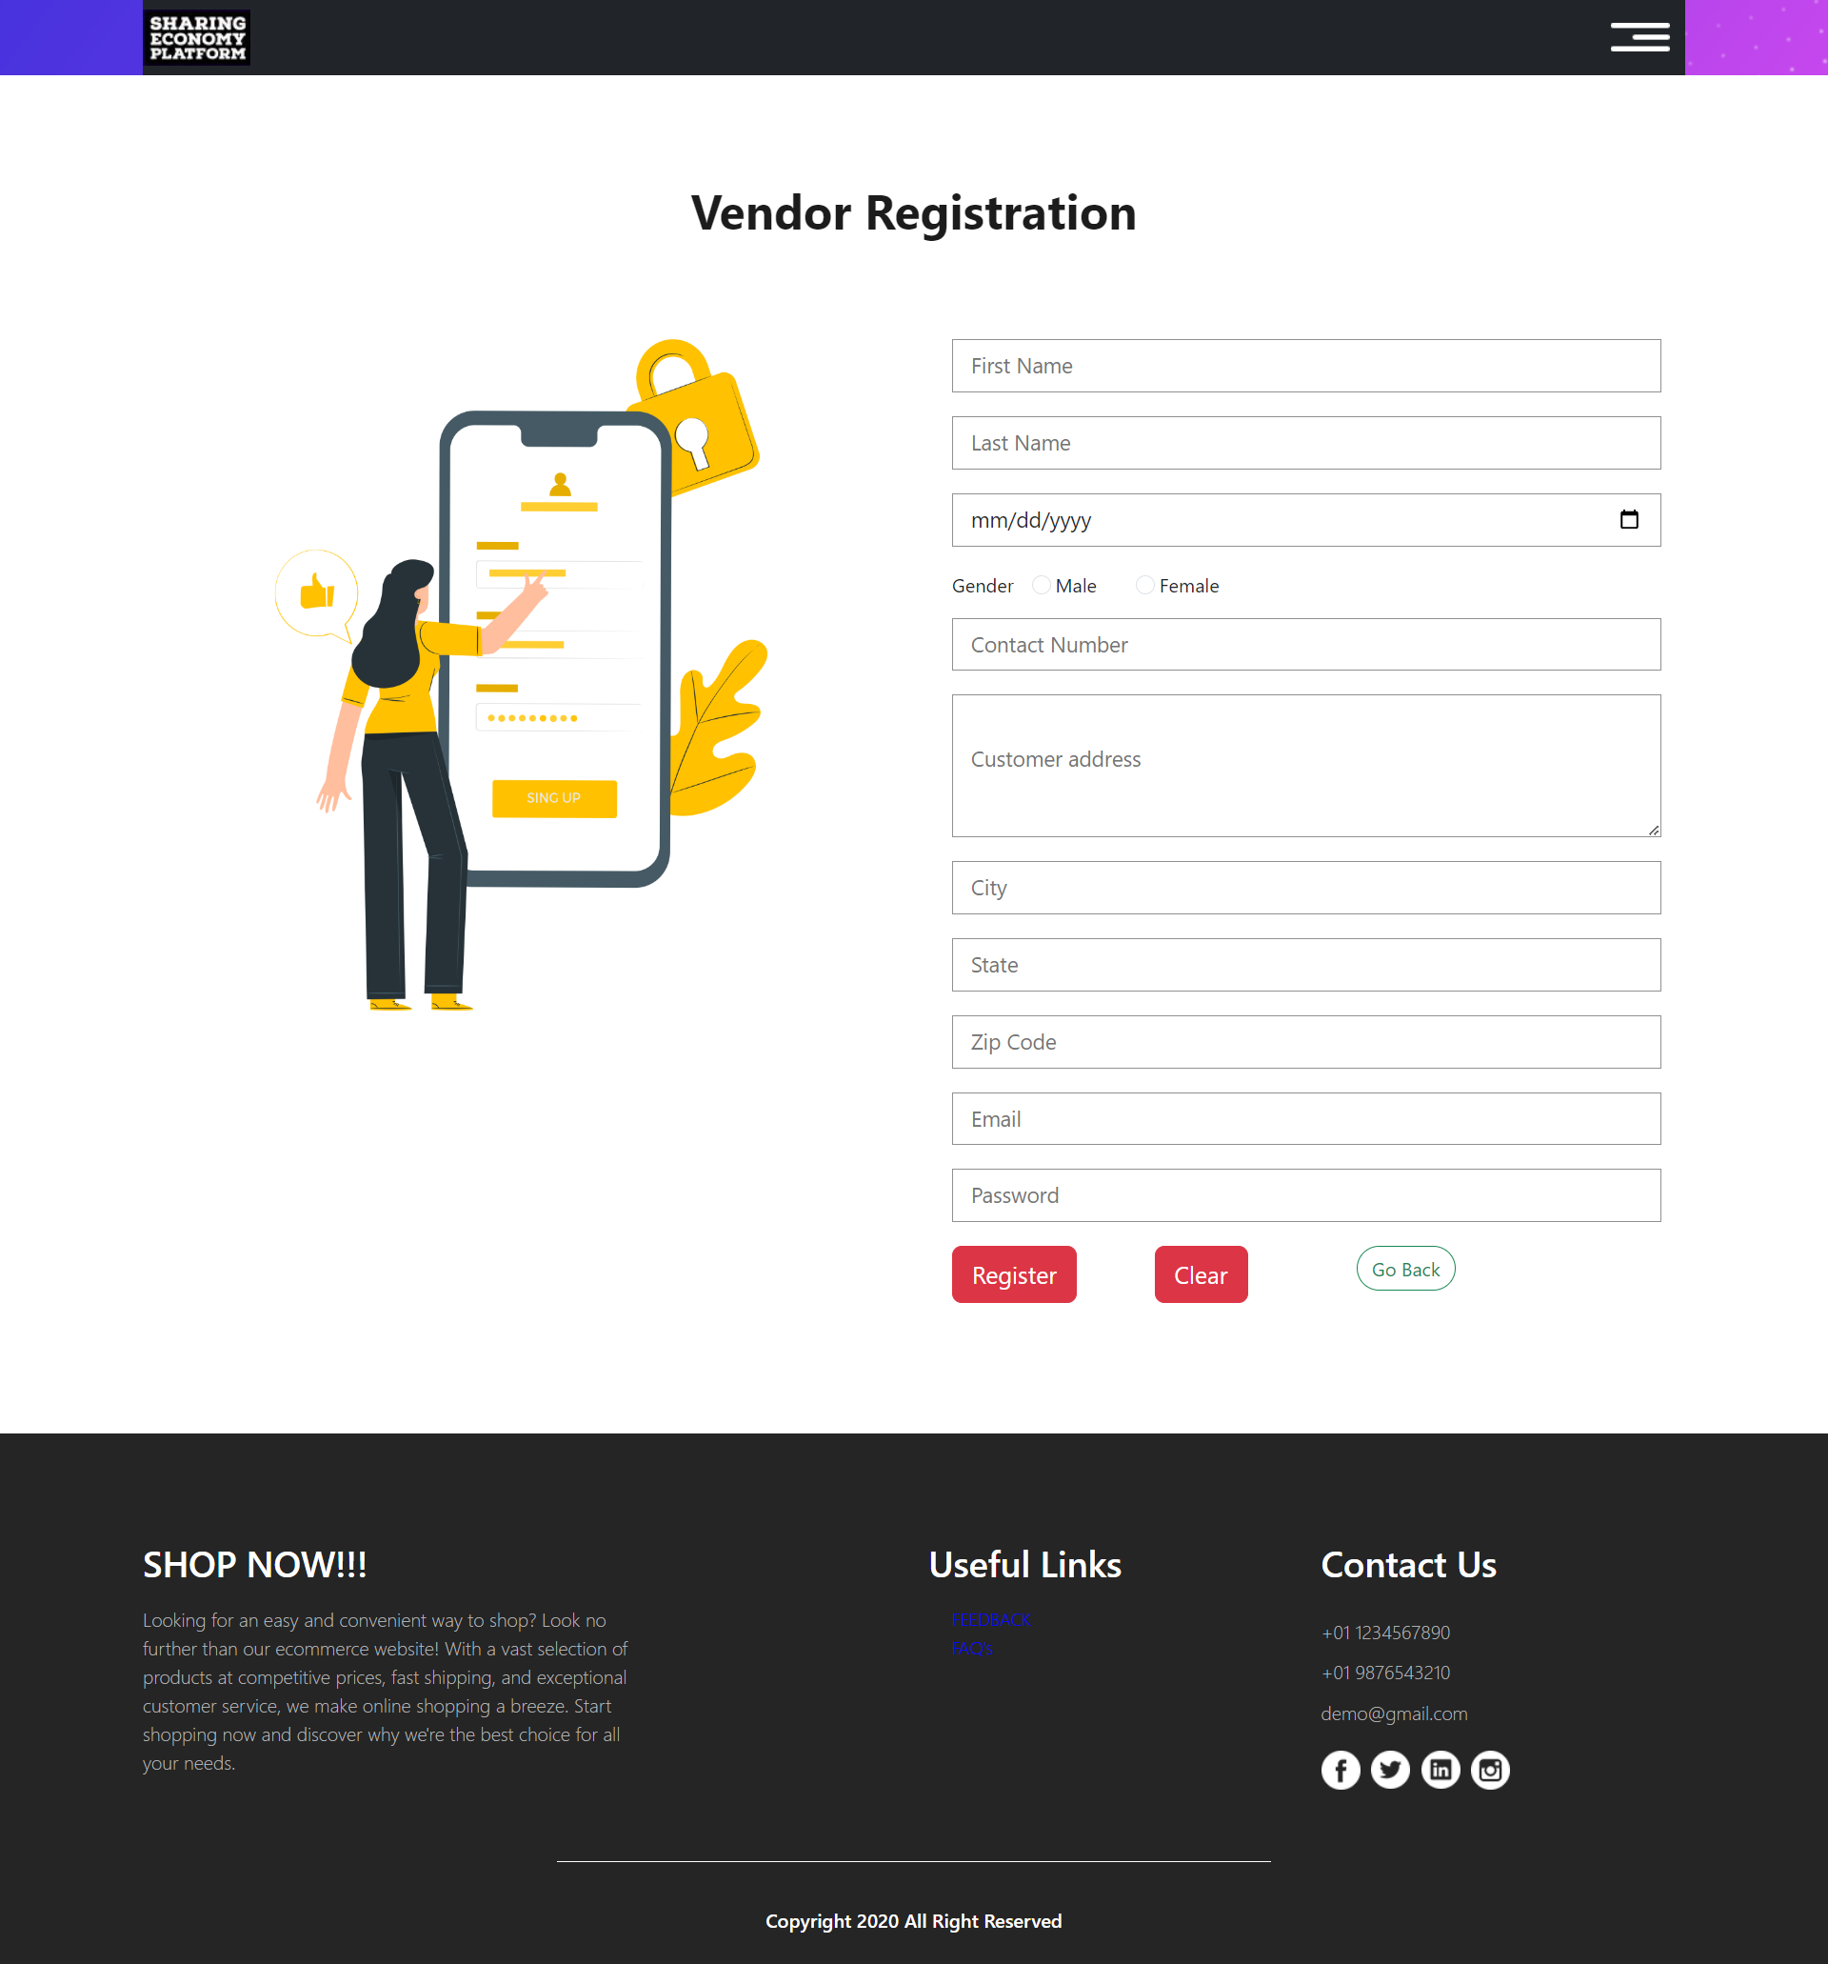
7. Result
Vendor and Customer registration page

Slide 11
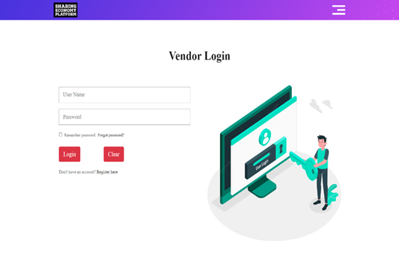
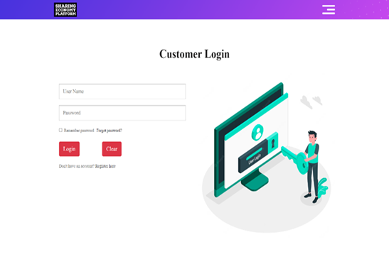
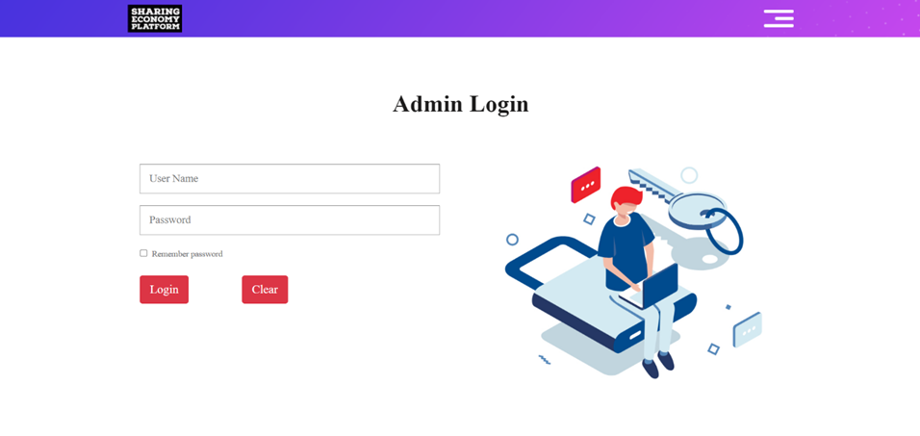
7. Result
Vendor, Customer, Admin login page

Slide 12
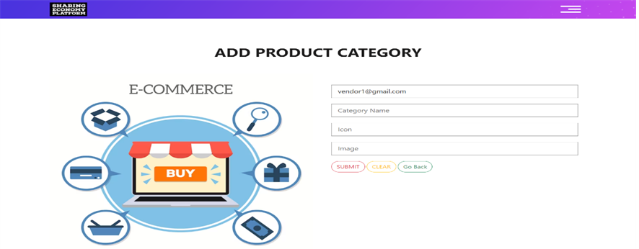
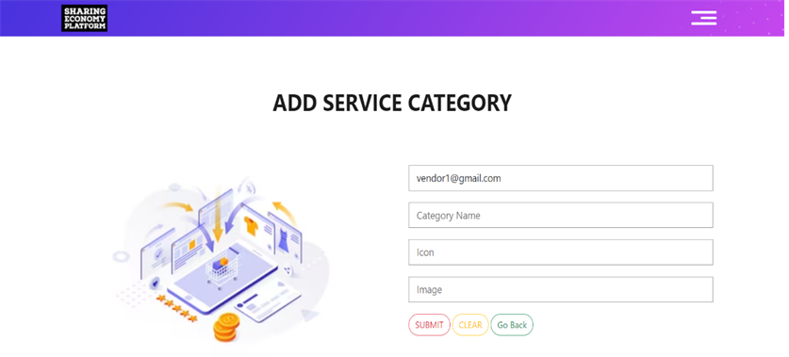
7. Result
Add product/service Categories

Slide 13
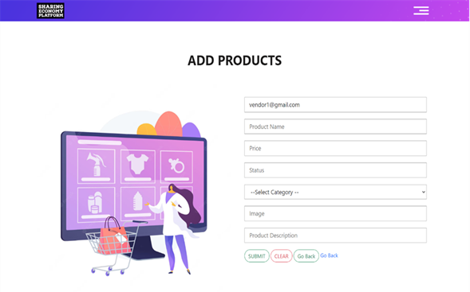
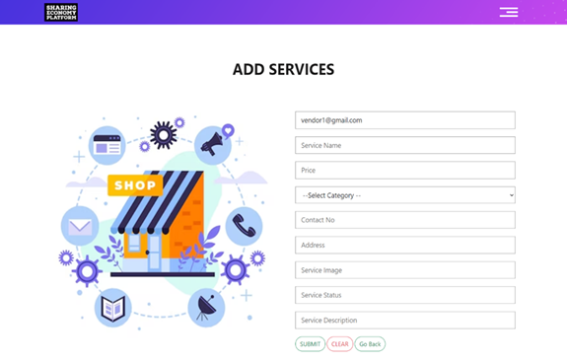
7. Result
Add products/services

Slide 14
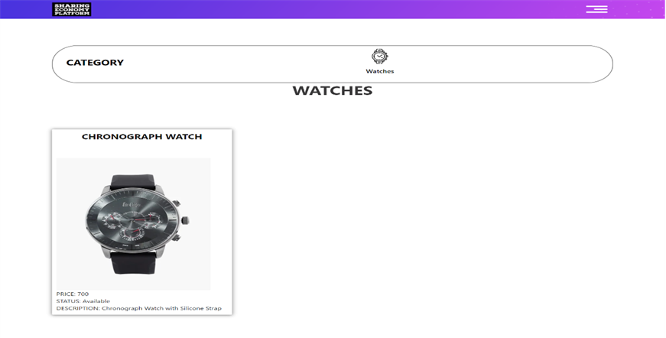
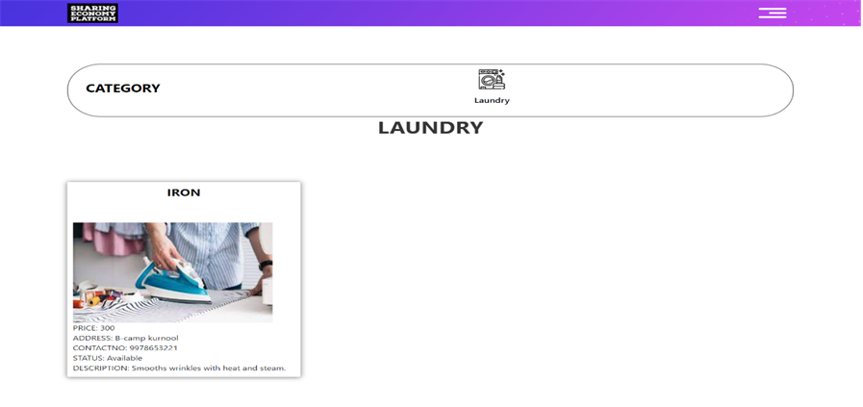
7. Result
View products/services

Slide 15
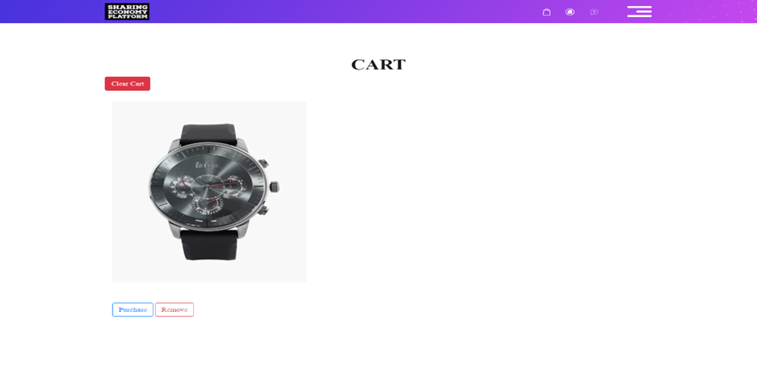
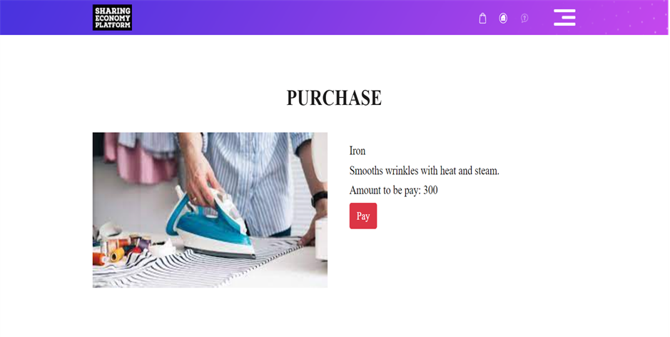
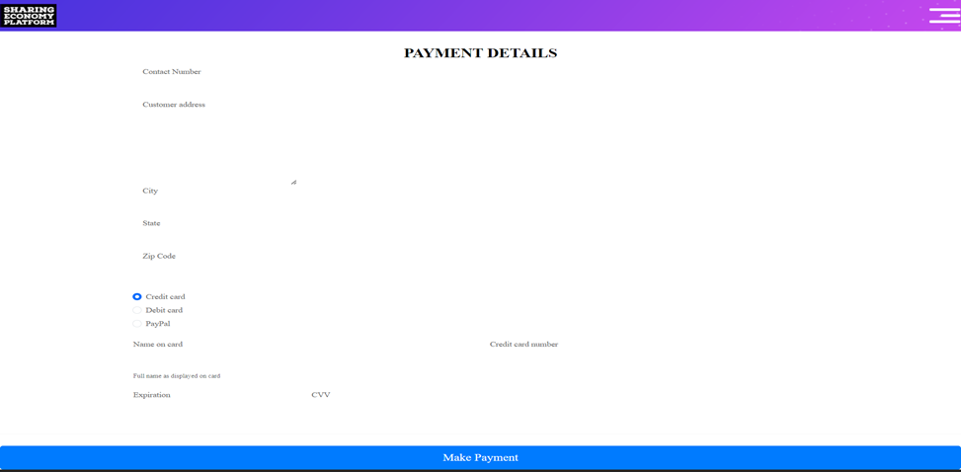
7. Result
Cart, Purchase, Bill Generation

Slide 16
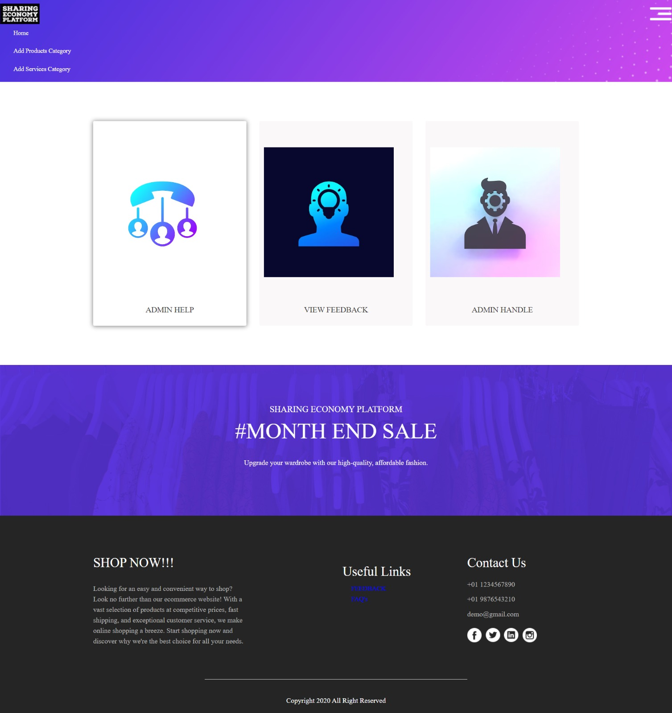
7. Result
Admin homepage

Slide 17
8. Future Scope
Integration of Artificial Intelligence: Sharing economy platforms can leverage AI to improve their efficiency and enhance the user experience. AI-powered chatbots, voice assistants, and recommendation engines can personalize the user experience and help users find the resources and services they need quickly.
Collaboration with Governments: Sharing economy platforms can collaborate with governments to create policies that promote sharing and sustainability. Governments can provide tax incentives for users of sharing economy platforms, and platforms can work with governments to create regulations that ensure the safety and security of users.

Slide 18
9. Conclusion
In conclusion, sharing economy platforms have revolutionized the way people share resources and services.
They have provided a cost-effective and efficient way for individuals and businesses to access and share resources, which has led to more sustainable consumption patterns and reduced waste.

Slide 19
THANK YOU!

